Slide 1

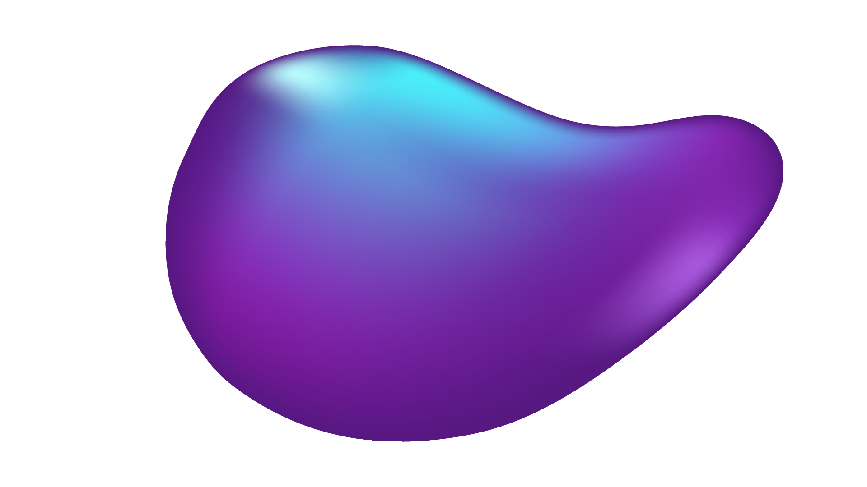

Heart Rate Diseases

Slide 2
TABLE OF CONTENTS
01
02
03
04
05
ABOUT THE PROJECT
Israa_Ayman_Daif
Numerical EDA
Ali_Zain
visualization EDA & Powerbi
Batool
Algorithm
Zeyad
Complet_Algorithm
Nancy

Slide 3
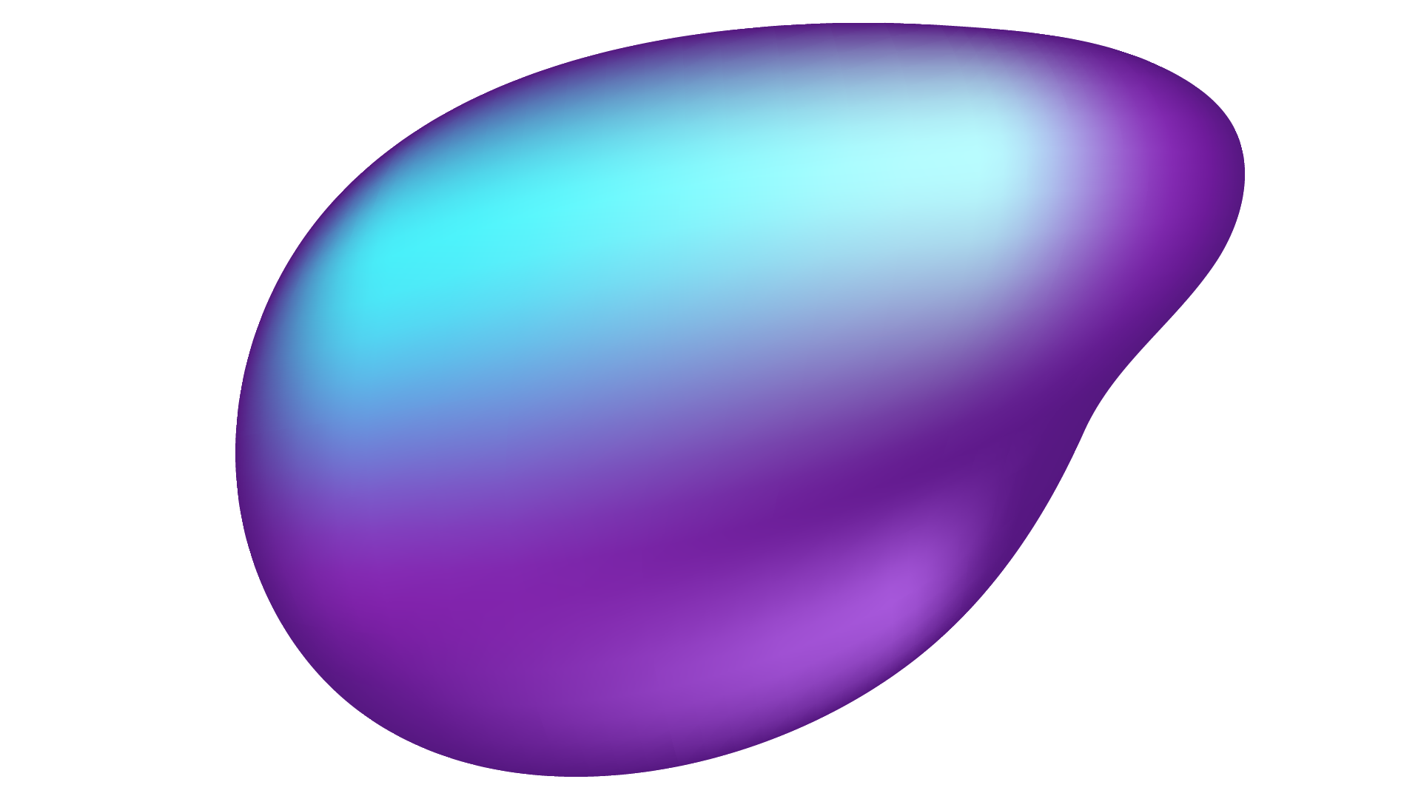

01
ABOUT THE PROJECT

Slide 4
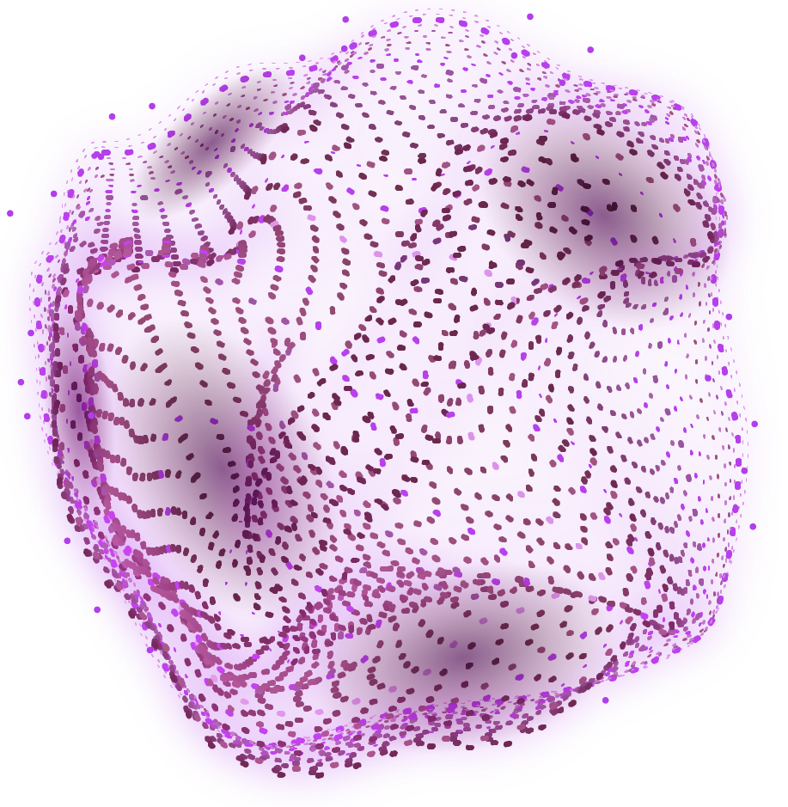
Heart disease, in particular, is one of the most common cardiovascular diseases (CVDs) and a leading cause of death globally. The World Health Organization (WHO) estimates that 17.9 million deaths worldwide occur as a result of CVDs, accounting for 32% of all fatalities. 85% of these are the result of strokes and heart attacks. These concerning figures emphasize how crucial early detection and prevention are. The third Sustainable Development Goal of the UN, "Good Health and Well-Being," is in line with my project. Reducing mortality from non-communicable diseases, such as heart problems, is emphasized by this aim. My project uses machine learning and data analysis to determine a person's risk of heart disease based on multiple important characteristics. By doing this, it might perhaps help

Slide 5
PROJECT GOALS
GOAL 1
Detect_this Diseases
GOAL 2
High Freqancy
GOAL 3
Good Health and Well-Being

Slide 6
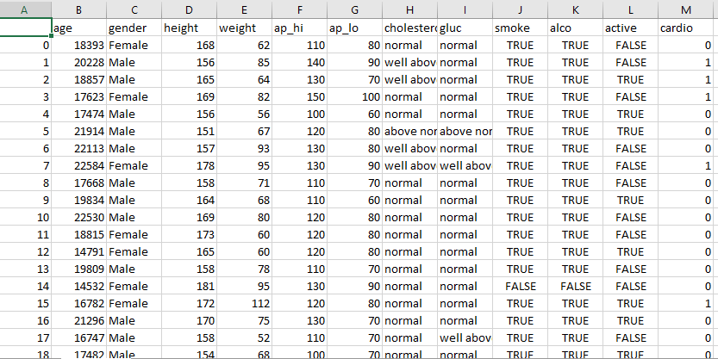
Read Data

Slide 7
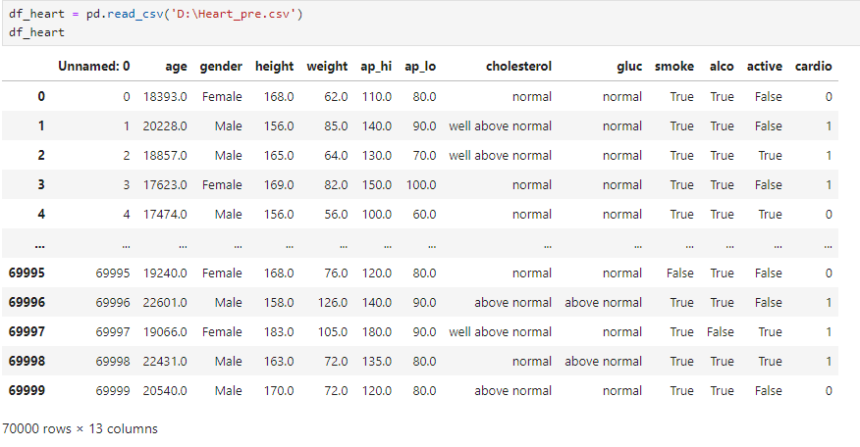
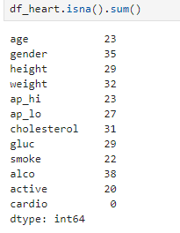
Read Data
Show Data
calculates and returns the total number of missing

Slide 8
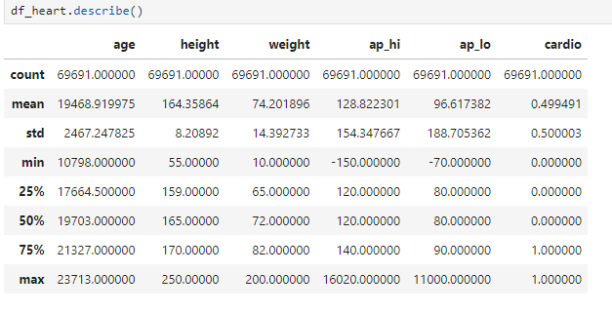
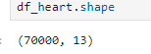
Read Data
Show Shape
Descriptive Statistics

Slide 9
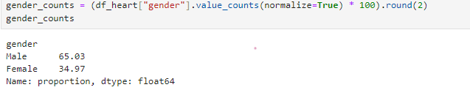
Read Data
calculate the percentage of each gender

Slide 10
02
Numerical EDA

Slide 11
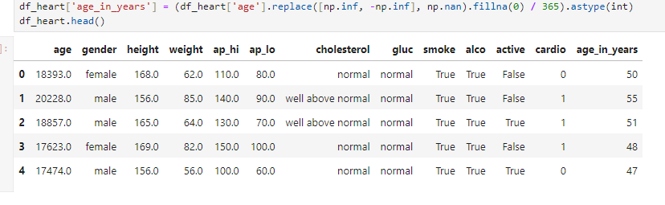
Numerical EDA
Handel the missing value at the age in years

Slide 12
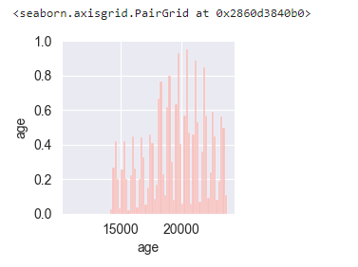
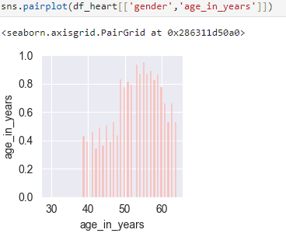
Numerical EDA
After
Before

Slide 13
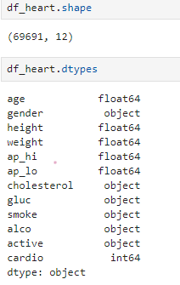
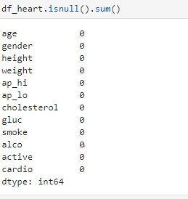
Numerical EDA
calculates and returns the total number of missing
Show shape and type Data

Slide 14
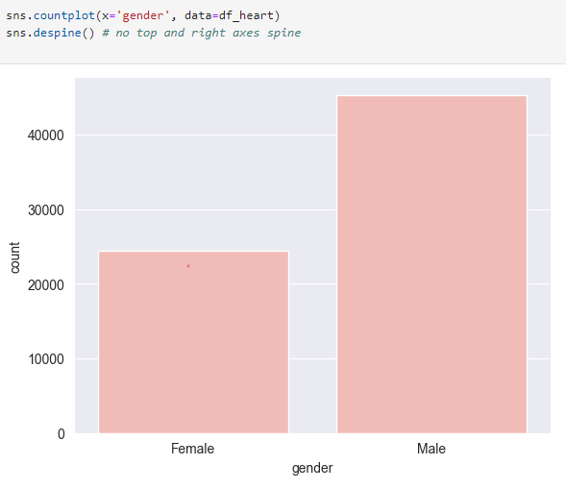
Numerical EDA
Show Female and Male

Slide 15
03
Visualization EDA

Slide 16
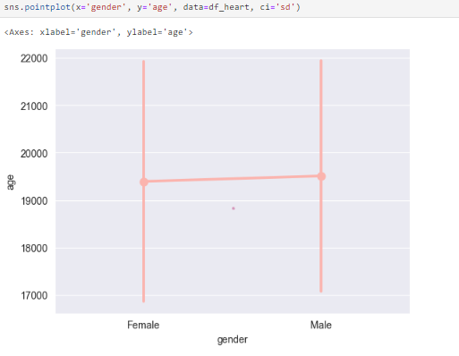
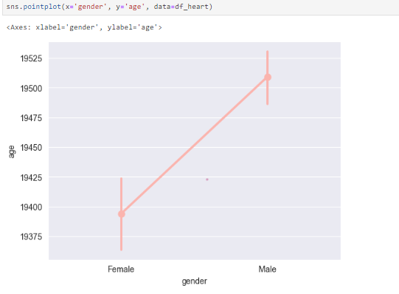
Visualization EDA
show standard deviation of observations instead of a confidence interval
grouped by a categorical variable

Slide 17
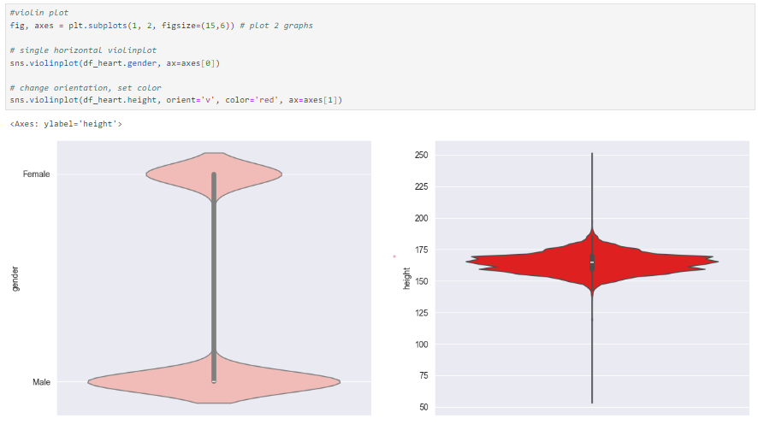
Visualization EDA

Slide 18
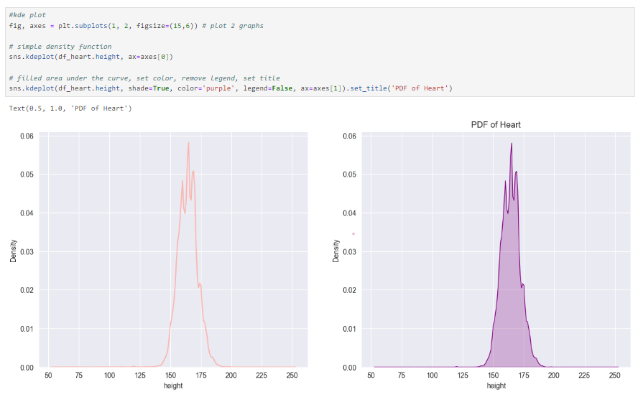
Visualization EDA

Slide 19
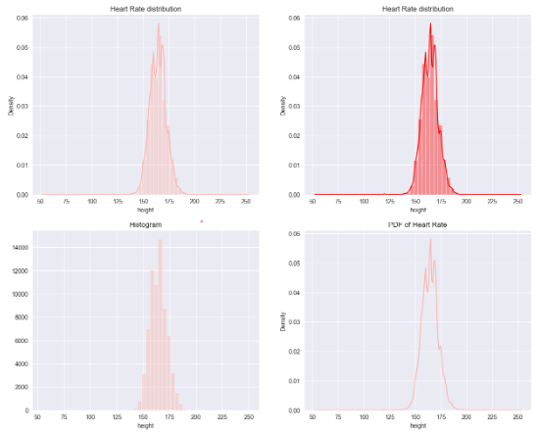
Visualization EDA

Slide 20
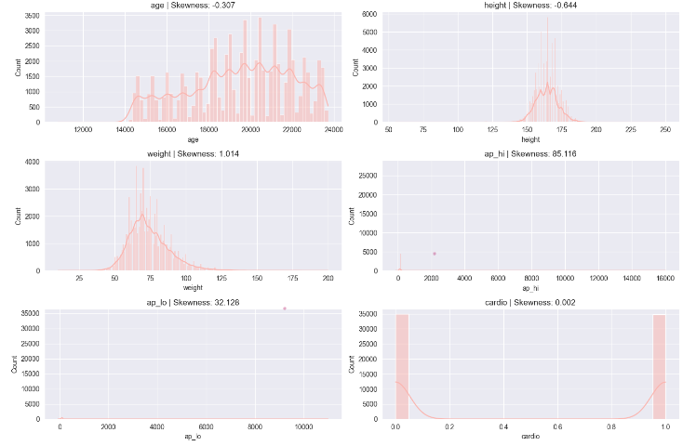
Visualization EDA

Slide 21
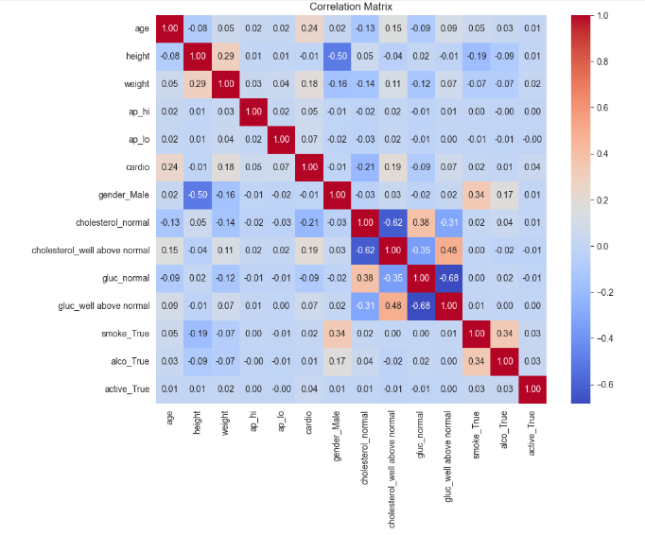
Visualization EDA

Slide 22
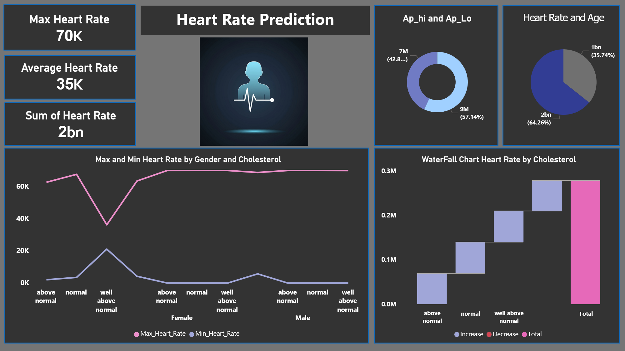
Powerbi Dashboard

Slide 23
04
Modeling the Dataset

Slide 24
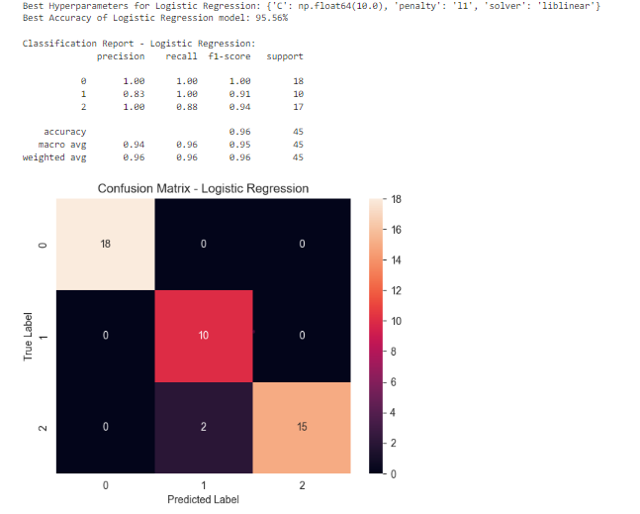
Logistic Regression

Slide 25
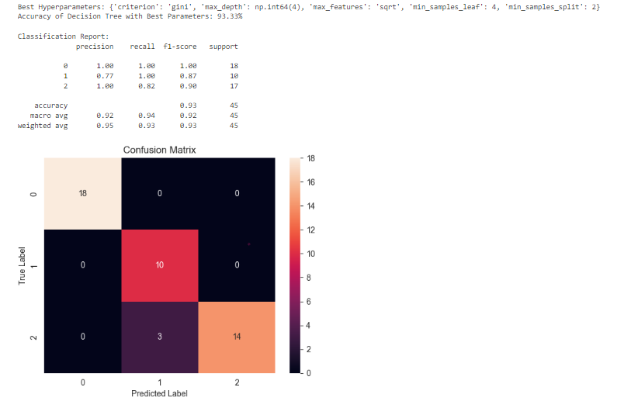
Decision Tree

Slide 26
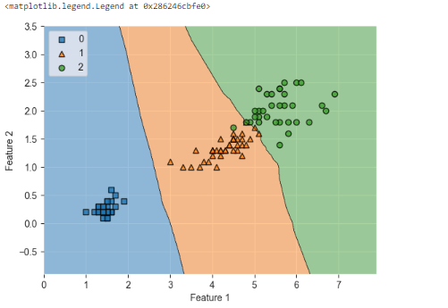
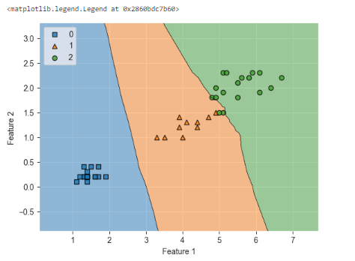
K_NN
Training
Testing

Slide 27
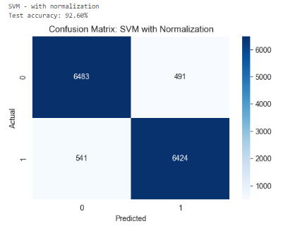
Support Vector Machine

Slide 28
Compare Between Modeling
NAME Of Modeling | Accurecy
Logistic Regression | 95.56%
Decision Tree | 93.33%
K_NN | 95.56%
Support Vector Machine | 92.60%

Slide 29
THANKS!

Slide 30
RESOURCES
Data Set
Kaggle
Writing
Jupiter
Prestation
PowerPoint

